Slide 1

DATABASE MANAGEMENT SYSTEM PROJECT
NATIONAL INSTITUTE OF TECHNOLOGY WARANGAL
ON
RUNNING CREW MANAGEMENT FOR RAILWAYS
DESIGNED BY :
21CSB0A52 S.SAMHITHA
21CSB0A27 K.JAHNAVI

Slide 2


CONTENT :
PROBLEM STATEMENT
ER DIAGRAM
RELATIONAL SCHEMA
ASSUMPTIONS
NORMALISATION
QUERIES ON DATABASE

Slide 3
PROBLEM STATEMENT :
Our comprehensive database system is designed to efficiently store and monitor critical details and status updates of railway crew. It provides a centralized platform for easy tracking of mileage, training, and medical fitness records, with an efficient algorithm that retrieves crew availability and enables duty assignments. The system also tracks crew movement on duty, recording distance covered for mileage updates. Our system ensures only medically and technically fit crew are assigned duties, enhancing railway safety and efficiency. Accurate records can be maintained, progress monitored, and salaries calculated based on performance.

Slide 4
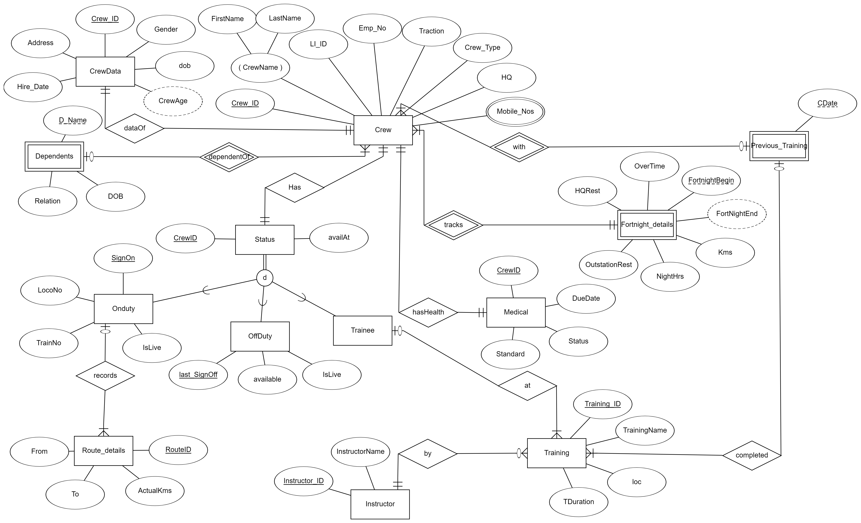
ENTITY RELATIONSHIP MODEL
“
”

Slide 5
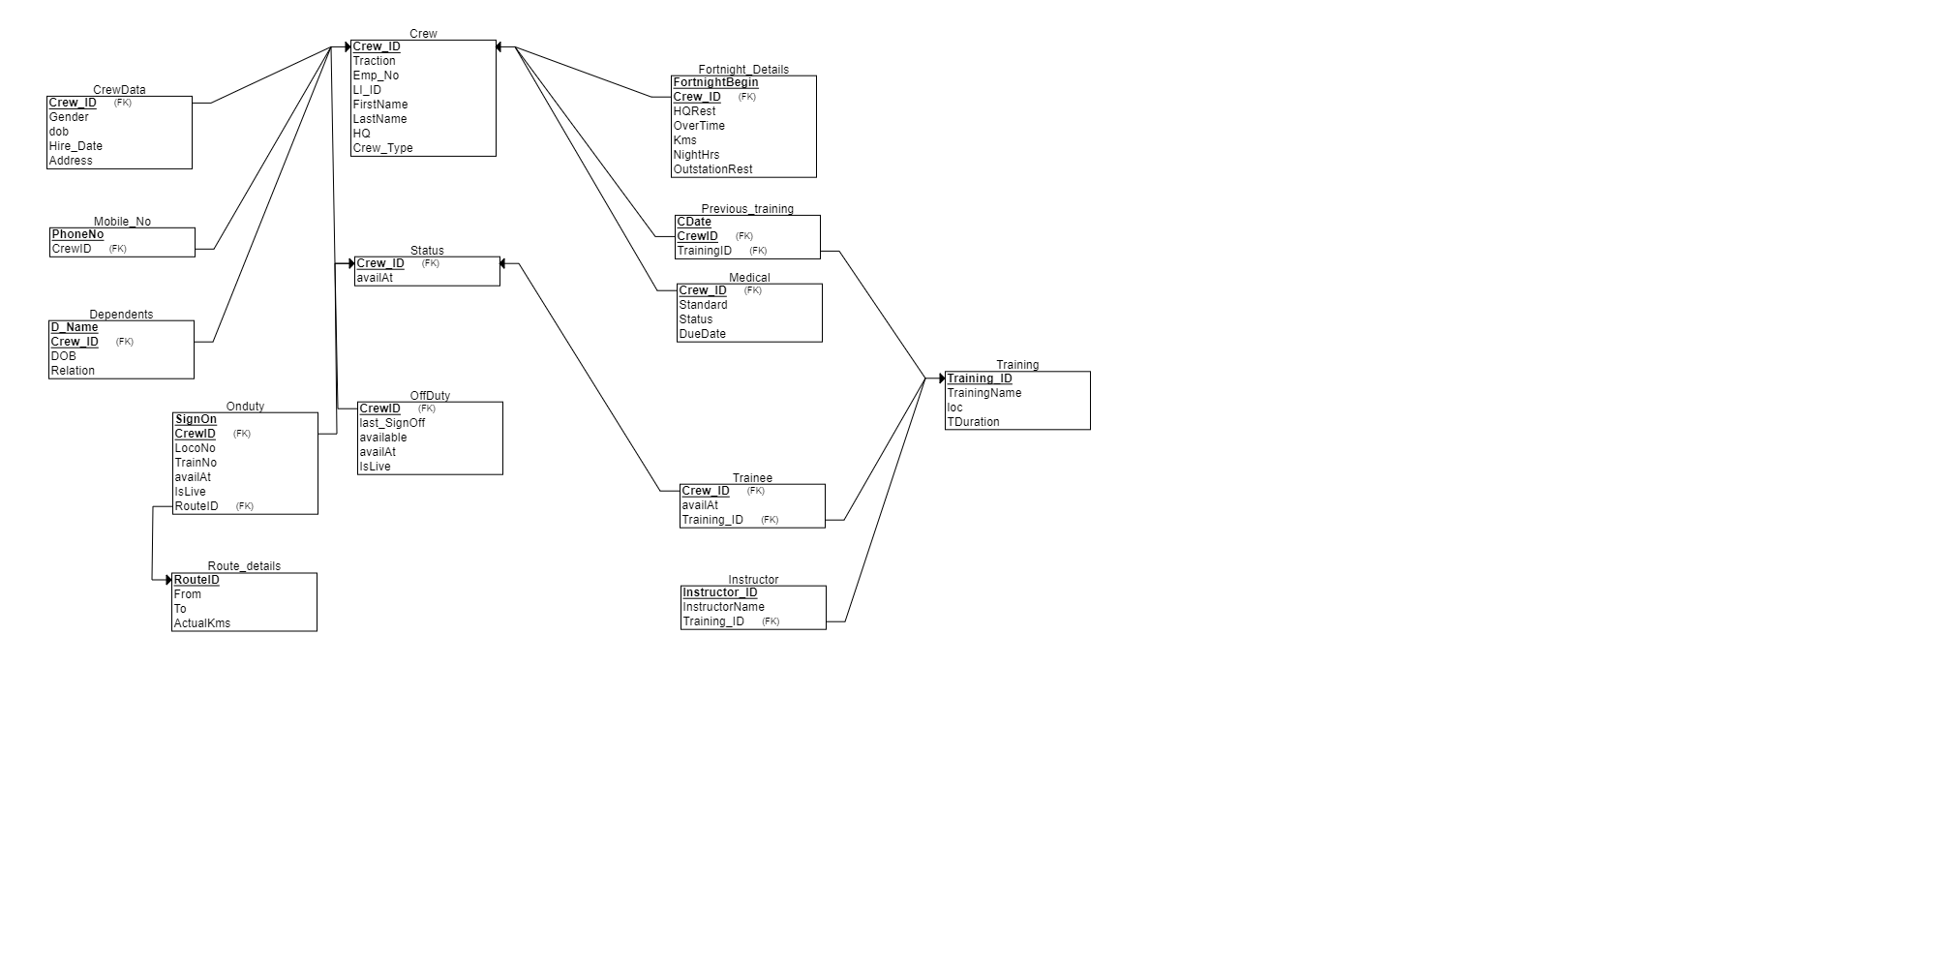
RELATIONAL SCHEMA
“
”

Slide 6
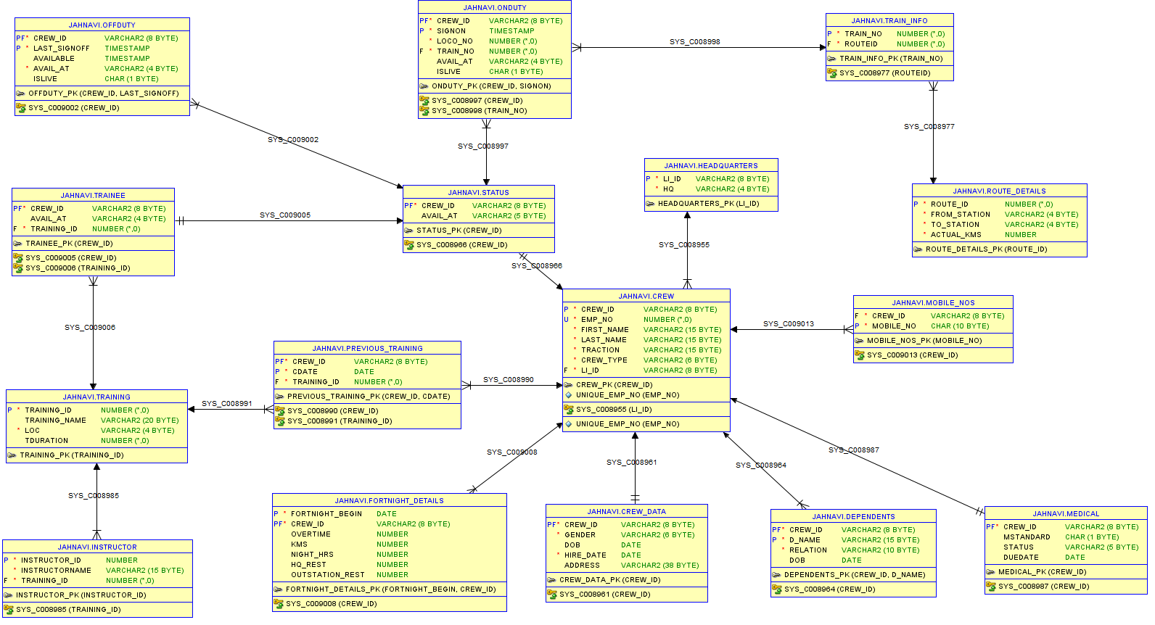

Slide 7
DataOf: Each crew member has their own data, and no data is left without being associated with a crew member, hence a one-to-one relationship with total participation.
Dependents: A crew member may or may not have a dependent, but a dependent belongs to only one crew member, resulting in partial participation for crew members and total participation for dependents . Each crew member has their own status and medical, and every status and medical is associated with a single crew member, leading to a one-to-one relationship with total participation for both.
Each crew member has their own status and medical, and every status and medical is associated with a single crew member, leading to a one-to-one relationship with total participation for both.
Fortnight details: Every crew member is associated with at least one fortnight detail, and each fortnight detail is associated with a single crew member, resulting in total participation for both entities and a many-to-one relationship between fortnight details and crew members.
Previous trainings: Some crew members may not have previous trainings, but every trained crew member has a previous training record, resulting in partial participation for crew members and total participation for trained crew members. It is a many-to-one relationship.
ASSUMPTIONS

Slide 8
Status: Crew members must belong to any one of the status(OnDuty, Off Duty, Trainee) as part of total participation. This disjoint nature ensures that a crew member can only be in one
status at a time.
Every OnDuty has a route associated (total participation), but some routes may not be recorded yet in OnDuty at a given instance (partial participation). It is a many-to-one relationship
from OnDuty to Route_details, ensuring different RouteIDs cannot be associated with the same OnDuty.
Trainee: Trainees must attend training (total participation), but not all trainings may take place at a given instance (partial participation). It is a oneto-many relationship between trainings and trainees.
Total participation in previous_training and one-to-many relationship between training and previous_trainings, also our database prevents multiple trainings by a crew member on the same date.
'islive' ensures that an entry is live. When a new entry is made in either onduty or offduty or trainee , it automatically marks other live records of the corresponding crew as unlive. This maintains data integrity and promotes efficiency in the database( and implemented by triggers on these tables ).

Slide 9
NORMALISATION
CREW(CREW_ID,TRACTION,EMP_NO,LI_ID,FIRST_NAME,LAST_NAME,CREW_TYPE,HQ)
This relation is in 1NF as there are no multivalued attributes.
This relation is in 2NF as there are no partial dependencies (as candidate keys are single attributes only).
LI_ID -> HQ (This transitive dependency violates 3NF criteria)So, decomposing this relation into
1.CREW
2. HEADQUARTERS
CREW(CREW_ID,TRACTION,EMP_NO,LI_ID,FIRST_NAME,LAST_NAME,CREW_TYPE)
HEADQUARTERS(LI_ID,HQ)
BOTH THE RELATIONS ARE IN BCNF

Slide 10
CREWDATA(CREW_ID,CREW_NAME,GENDER,DOB,HIRE_DATE,ADDRESS)
As all the determinants in the FDs are key (CREW_ID) , the relation’s highest normal form is BCNF.
MOBILE_NOS(MOBILE_NO,CREW_ID)
This is in BCNF as this is a two-attribute relation!
STATUS(CREW_ID,AVAIL_AT)
This is in BCNF as this is a two-attribute relation!
DEPENDENTS(CREW_ID,D_NAME,RELATION,DOB)
As all the determinants in the FDs are key (CREW_ID D_NAME), the relation’s highest normal form is BCNF.

Slide 11
ONDUTY(CREW_ID,SIGNON,LOCO_NO,TRAIN_NO,AVAIL_AT,ISLIVE,ROUTE_ID)
This relation is in 1NF as there are no multivalued attributes.
This relation is in 2NF as there are no partial dependencies , where CREW_ID alone or SIGNON alone can determine one or more attributes.
TRAIN_NO -> ROUTE_ID
This is the only transitive dependency violating 3NF, so decomposing this relation into :
1.ONDUTY
2. TRAIN_INFO
ONDUTY(CREW_ID, SIGNON,LOCO_NO,TRAIN_NO,AVAIL_AT,ISLIVE)
As all the determinants in the FDs are key (CREW_ID SIGNON), the relation’s highest normal form is BCNF.

Slide 12
TRAIN_INFO(TRAIN_NO,ROUTE_ID)
This is in BCNF as this is a two-attribute relation!
OFFDUTY(CREW_ID, LAST_SIGNOFF,AVAILABLE,AVAIL_AT,ISLIVE)
As all the determinants in the FDs are key (CREW_ID LAST_SIGNOFF), the relation’s highest normal form is BCNF
TRAINEE(CREW_ID, AVAIL_AT,TRAINING_ID)
As all the determinants in the FDs are key (CREW_ID), the relation’s highest normal form is BCNF.
INSTRUCTOR(INSTRUCTOR_ID,INSTRUCTORNAME,TRAINING_ID)
As all the determinants in the FDs are key (INSTRUCTOR_ID), the relation’s highest normal form is BCNF.

Slide 13
TRAINING(TRAINING_ID, TRAINING_NAME,LOC,TDURATION)
As all the determinants in the FDs are key (TRAINING_ID), the relation’s highest normal form is BCNF.
PREVIOUS_TRAINING(CREW_ID, CDATE,TRAINING_ID)
As all the determinants in the FDs are key (CREW_ID CDATE), the relation’s highest normal form is BCNF.
ROUTE_DETAILS(ROUTE_ID,FROM,TO,ACTUAL_KMS)
As all the determinants in the FDs are key (ROUTE_ID , FROM TO),relation’s highest normal form is BCNF.
FORTNIGHT_DETAILS(FORTNIGHT_BEGIN,CREW_ID,HQ_REST,OVERTIME,KMS,NIGHT_HRS, OUTSTATION_REST)
As all the determinants in the FDs are key (FORTNIGHT_BEGIN CREW_ID), the relation’s highest normal form is BCNF.

Slide 14
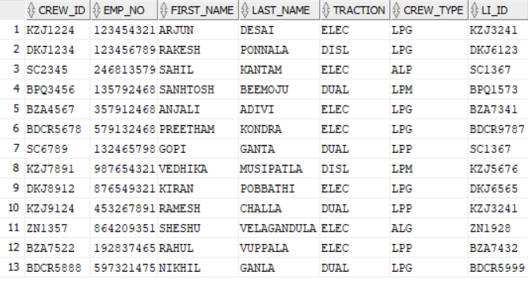
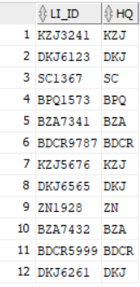
TABLES
CREW HEAD QUARTERS

Slide 15
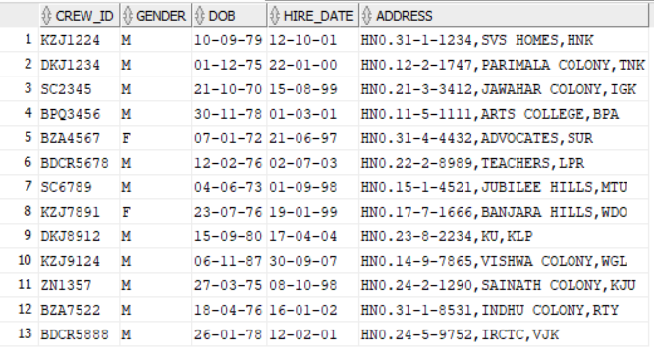
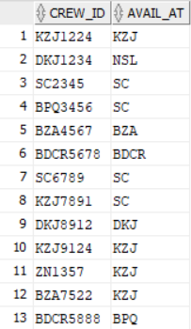
CREW_DATA
STATUS

Slide 16
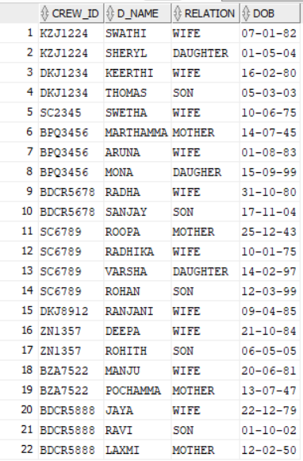
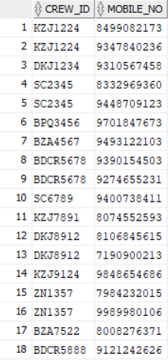
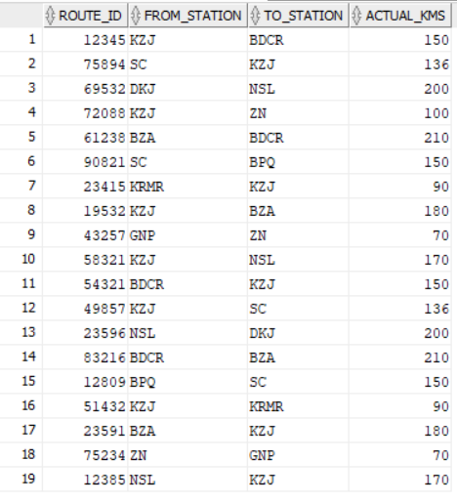
MOBILE NOS
ROUTE DETAILS
DEPENDENTS

Slide 17
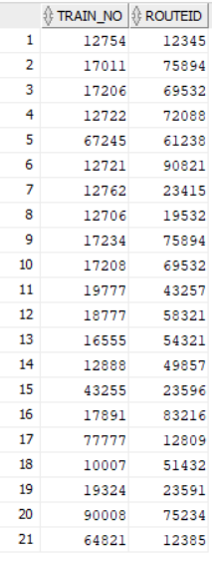
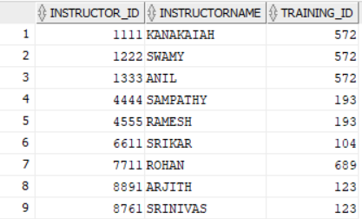
TRAIN INFO
INSTRUCTOR

Slide 18
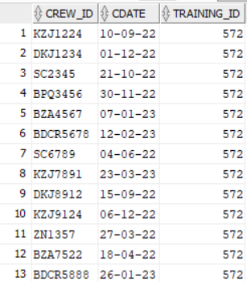
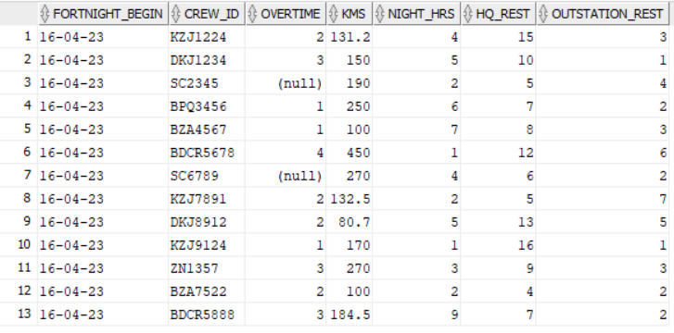
PREVIOUS_TRAINING
FORTNIGHT DETAILS

Slide 19

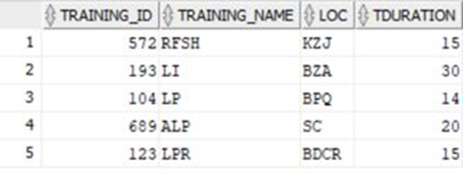
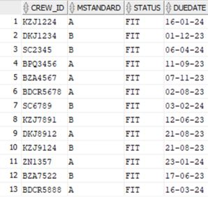
MEDICAL :

Slide 20
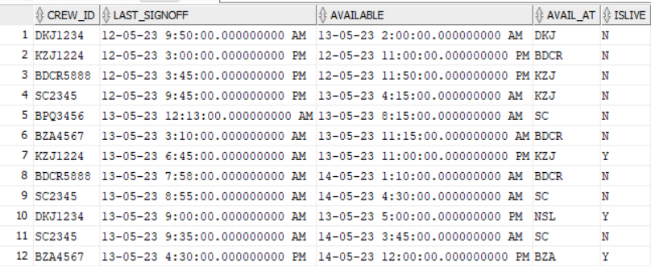
OFFDUTY

Slide 21
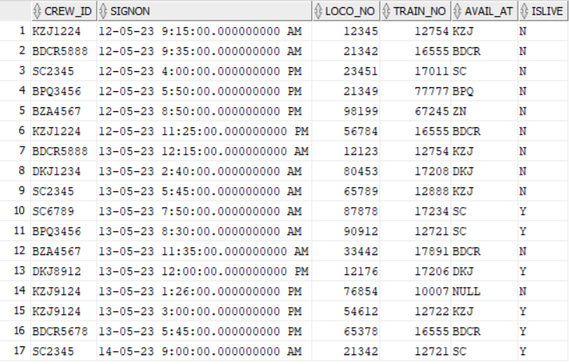
ONDUTY

Slide 22
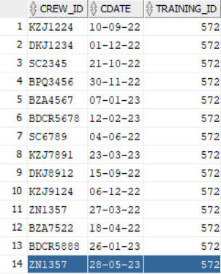
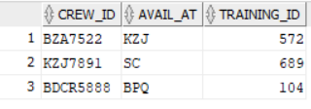
PREVIOUS_TRAINING
TRAINEE

Slide 23
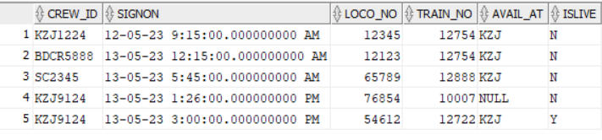
QUERIES ON DATABASE :
Find the employees who have/had there on duty in kazipet station.
SELECT * FROM ONDUTY
WHERE TRAIN_NO IN(SELECT TRAIN_NO
FROM TRAIN_INFO
WHERE ROUTEID IN(SELECT ROUTE_ID
FROM ROUTE_DETAILS
WHERE FROM_STATION='KZJ'));

Slide 24
Find the employees who are available at SC after 2:00:00 on 14th may,2023 and assign duty to the first available employee to work for train_no ‘12721’ at 09:00:00.
DECLARE
C OFFDUTY.CREW_ID%TYPE;
BEGIN
SELECT CREW_ID INTO C FROM OFFDUTY
WHERE ISLIVE='Y' AND AVAIL_AT='SC' AND AVAILABLE>'14-05-2023 02:00:00’
ORDER BY AVAILABLE
FETCH FIRST 1 ROW ONLY;
INSERT INTO ONDUTY VALUES(C,TIMESTAMP'2023-05-14 09:00:00',21342,12721,'SC','Y’);
EXCEPTION
WHEN NO_DATA_FOUND THEN
DBMS_OUTPUT.PUT_LINE('NO CREW AVAILABLE!!’);
END;

Slide 25
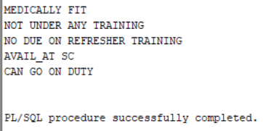
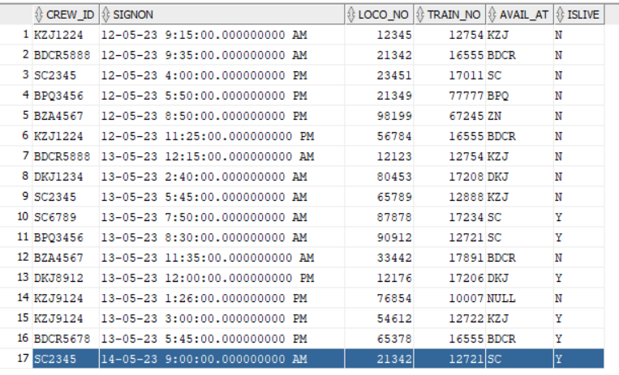

Slide 26
Write a PL/ SQL block to know whether an employee E is available at/before time T or not.
If Available display the available time.
DECLARE
E CREW.CREW_ID%TYPE;
T TIMESTAMP;
A TIMESTAMP;
BEGINE:=&E;
T:=&T;
SELECT AVAILABLE INTO A FROM OFFDUTY
WHERE CREW_ID=E AND AVAILABLE<T AND ISLIVE='Y’;
DBMS_OUTPUT.PUT_LINE('AVAILABLE AT '||A);
EXCEPTION
WHEN NO_DATA_FOUND THEN
DBMS_OUTPUT.PUT_LINE(E|| 'IS NOT AVAILABLE BEFORE '||T);
END;

Slide 27
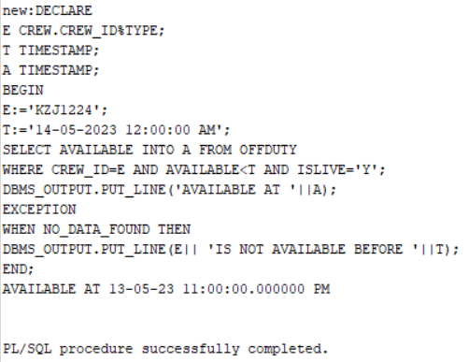

Slide 28
Write a PL/SQL block to find the employee’s current status.
DECLARE
FLAG INTEGER DEFAULT 1;
E CREW.CREW_ID%TYPE:=&E;
CURSOR C1 IS SELECT * FROM ONDUTY WHERE CREW_ID=E AND ISLIVE='Y’;
CURSOR C2 IS SELECT * FROM OFFDUTY WHERE CREW_ID=E AND ISLIVE='Y’;
CURSOR C3 IS SELECT * FROM TRAINEE WHERE CREW_ID=E;
R1 ONDUTY%ROWTYPE;
R2 OFFDUTY%ROWTYPE;
R3 TRAINEE%ROWTYPE;
BEGIN
OPEN C1;
OPEN C2;
OPEN C3;
FETCH C1 INTO R1;IF C1%NOTFOUNDTHEN FETCH C2 INTO R2;

Slide 29
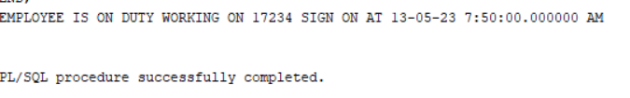
IF C2%NOTFOUNDTHENFETCH C3 INTO R3;
IF C3%NOTFOUND THEN
DBMS_OUTPUT.PUT_LINE('EMPLOYEE NOT FOUND!’);
ELSE
DBMS_OUTPUT.PUT_LINE('EMPLOYEE IS UNDER TRAINING’);
END IF;
ELSE
DBMS_OUTPUT.PUT_LINE('EMPLOYEE IS OFFDUTY ,WILL BE AVAILABLE AFTER '||R2.AVAILABLE);
END IF;
ELSE DBMS_OUTPUT.PUT_LINE('EMPLOYEE IS ON DUTY WORKING ON '||R1.TRAIN_NO||' SIGN ON AT '||R1.SIGNON);
END IF;
CLOSE C1;
CLOSE C2;
CLOSE C3;
END;
FOR EMPLOYEE ‘SC6789’

Slide 30
THANK YOU

